Slide 1

Digital Union
IMED 298
November 27,2022

Slide 2

Digital Union - Intro
Throughout the years, there has been a war between a lot of well-known media sources and video games.
Usually whenever there is an incident that occurs, video games are often ones to blame due to the type that media tends to put out there.
In other words, they’ll use video games as a way to fuel their one-sided argument.

Slide 3
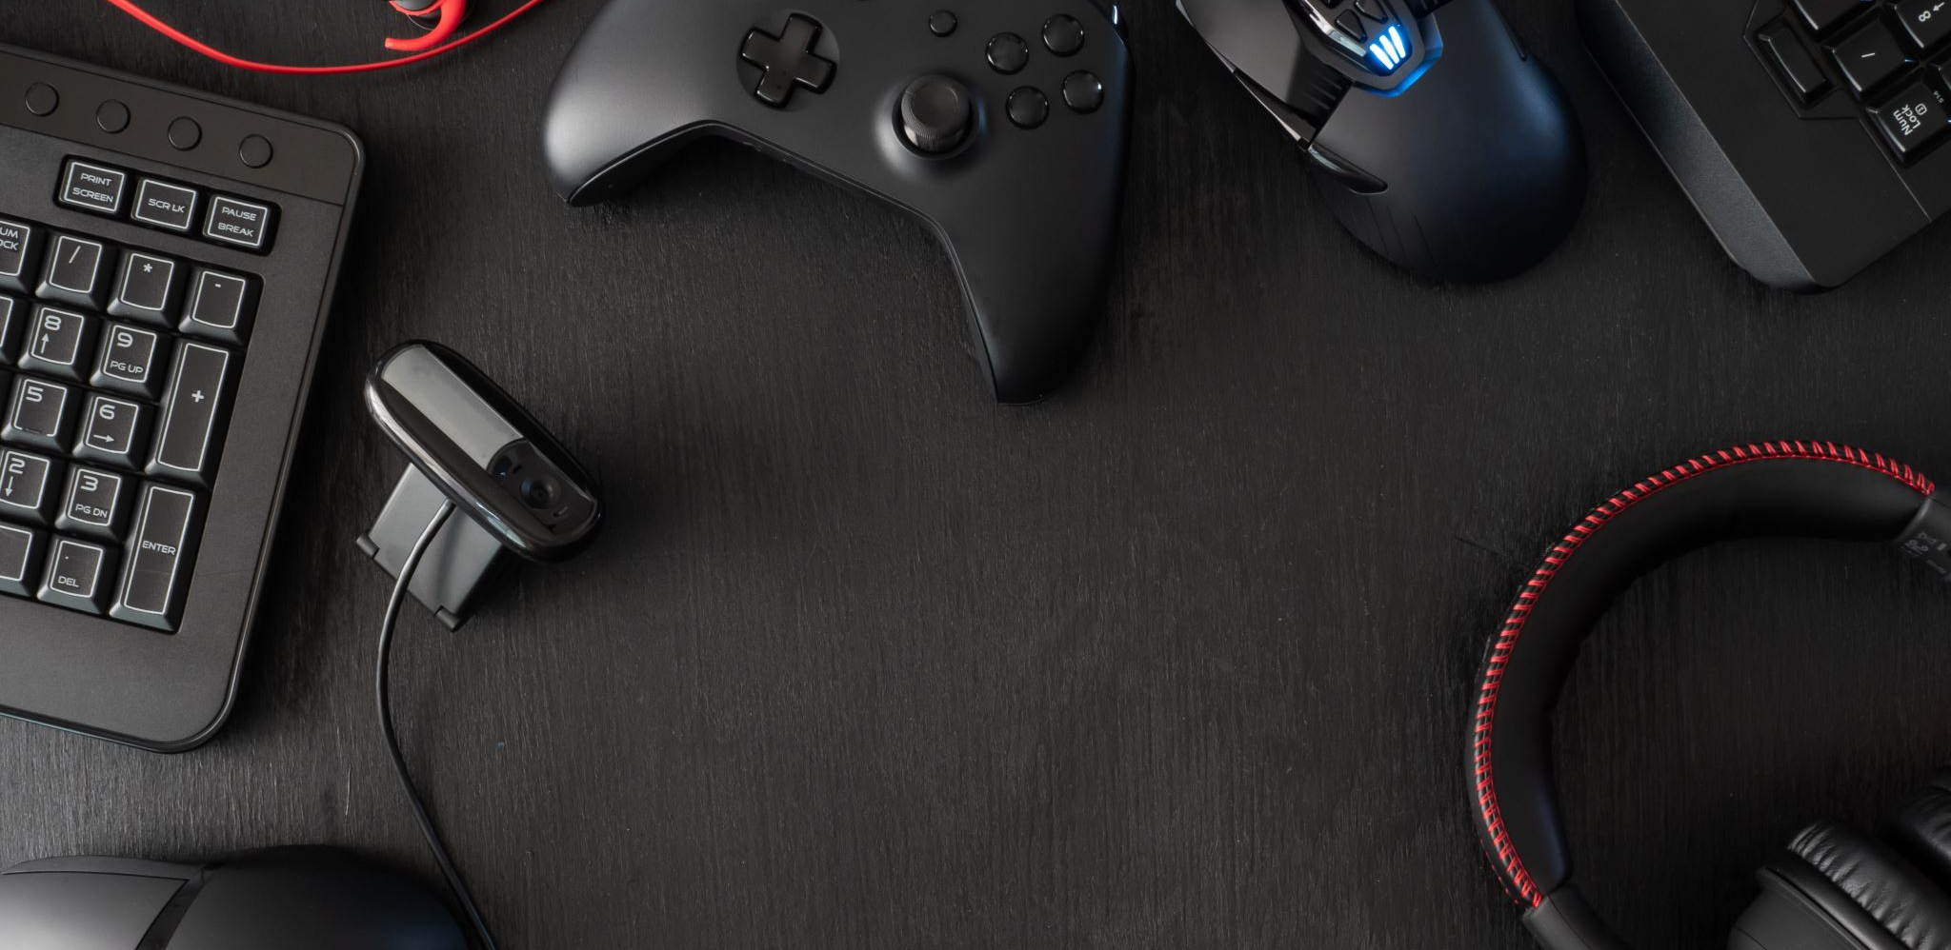
Digital Union - Purpose
This project’s purpose is to highlight both positives and negatives that have been said to received from video games and explain different types of methods used for the creation of purposeful games.
I was able to view some materials learned in previous classes as they related towards my project.
I went back to get better understanding of purposeful games.

Slide 4
Digital Union - Process
In order to complete this project, I went down the list of requirements in the learning objectives. With the tips from my advisor and my own understanding, I made separate documents for each part.
Set up a few meetings with Student Success.
I bought sticky notes to help remember my tasks and shortened them down as well with the different colors if needed.
I definitely had a bit of problems especially with my physical state being as it is currently. I had to remind myself as well to take breaks to prevent burn out.
I ended up increasing the amount of time I spent working on the project to increase the chances of completion.

Slide 5

Digital Union - Outcome
Annotated Reports for both positive impacts and negative stereotypes
An explanation of methods use for purposeful game design (x3)
Annotated Bibliographies for those methods
A Game Design Document
All in which can be found through the link below:
https://drive.google.com/drive/folders/1s91ksri97wX5uOAc_AHnVrRX8LhyiPyp?usp=share_link
This Photo by Unknown Author is licensed under CC BY-SA-NC

Slide 6

Digital Union - Challenges
My physical state as mentioned before.
My mental state.
Time Management Issues
Reaching Out issues
This wasn’t the outcome I was expecting at all.
I do wish that I started earlier
I also wish I knew a bit more about the programs I found to use for Game Design to use in my outcomes.
I also wish I could have applied the techniques learned from the meetings earlier.

Slide 7
Digital Union - Sources
Baio, A. (2022). Fox News asks if video games are to blame for gun violence, rather than guns. Indy100. https://www.indy100.com/news/fox-news-gun-violence-video-games.
MacDonald, K. (2022, May 24). Pushing Buttons: Why linking real-world violence to video games is a dangerous distraction. TheGuardian. https://www.theguardian.com/games/2022/may/24/pushing-buttons-violent-video-games.
Denson, T., F., Kasumovic, M., M., Harmon-Jones, E. (2022). Understanding the Desire to Play Violent Video Games: An Integrative Motivational Theory. American Psychological Association. 8(2). 161-173.
Spino, D. (2022, July 29). Are Video Games Really A Waste Of Time? Cinelinx. https://www.cinelinx.com/news/are-video-games-really-a-waste-of-time/.
Kanojia, A. [HealthyGamerGG]. (2021, November 4). Why Restricting Video Games As A Parent Is Actually Damaging. [Video]. Youtube. https://youtu.be/Q-tiTTvkHpw.
Miriyagalla, U., P., Kashima, E., S., Stukas, A. (2022, September 14). Stereotype content of players of violent and non-violent games. Asian Journal of Social Psychology. 1-12.
Deskins, T., G. (2013). Stereotypes in Video Games and How They Perpetuate Prejudice. McNair Scholars Research Journal. 6(5). 19-36.
Fox, T. (2015) Undertale (PC, Xbox, Playstation, Switch) [Video Game]. Fox, T.
PC Building Simulator (PC Version) [Video Game]. (2018). The Irregular Corporation, SH Games Studio.
Axel, D. (2020) Whatta Horrible Year (PC) [Video Game].
Lavandier, A., M. (2016, October 7). Debunked: The “Gamer” Stereotype. Medium. https://medium.com/the-nerd-castle/debunked-the-gamer-stereotype-69be0e4ee0d7
Kowert, R. [Psychgeist]. (2020, July 14). Academic Ramblings: Video Games and Friendship. [Video]. Youtube. https://youtu.be/OOrJe7Xn0po
Kowert, R. [Psychgeist]. (2021, November 24). Research Review: Positive Escapism. [Video]. Youtube. https://youtu.be/fOxb6ca8nG0
Desurvire, H. Wiberg, C. (2009, July). Game Usability Heuristics (PLAY) for Evaluating and Designing Better Games: The Next Iteration. ResearchGate. 577-566.
Harper, T. (2011, March 27). Rules, Rhetoric, and Genre: Procedural Rhetoric in Persona 3. Games and Culture. 1-19.
Treanor, M., Mateas, M. (2009). Newsgames: Procedural Rhetoric meets Political Cartoons. DiGRA Conference. 1-8.
Sonic Frontiers (PC, Switch, Xbox, PlayStation) [Video Game]. (2022). Sega, SEGA of America, Sega Europe Limited.
Overcooked 2 (PC, Xbox, Playstation, Switch) [Video Game]. (2018). Team17, Team17 Digital Limited.
Spleunky 2 (PC, Xbox, Playstation, Switch) [Video Game]. (2020). Mossmouth, Mossmouth, LLC.
Miller, C. (2013). The Gamification of Education. Developments in Business Simulation and Experiential Learning. 40. 196-200.
Jackbox Party Pack 3 (PC, Xbox, Playstation, Switch, Android, Apple) [Video Game]. (2016). Jackbox Games.
Young, S. Classcraft (Android, Apple) [Software]. (2014). Classcraft Studios Inc. https://www.classcraft.com/
Duolingo (Android, iOS, PC) (2012). [Platform]. Hacker, S., Ahn, L., v.
Versvik, M., Brand, J., Brooker, J. (2012) Kahoot! (Android, iOS, PC). [Platform].

